Slide 1
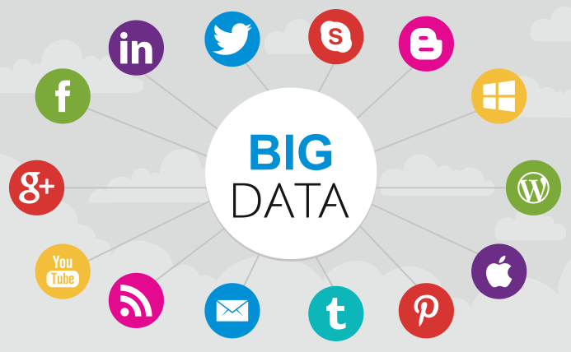
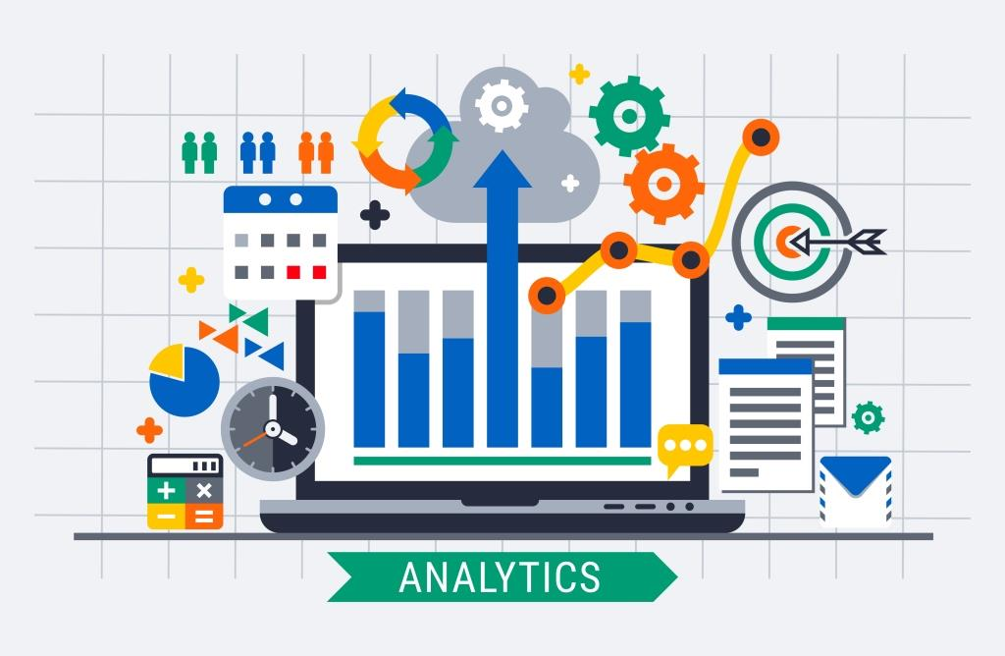
BIG DATA ANALYTICS

Slide 2
Big Data Analytics faculty Team
Course In charge : Pavithra.N
Course Instructors : Dr. Senthil Kumar S, Mr Amogh Kulkarni,Ms. N.Pavithra, Dr.S.P Anandharaj, Ms. Ila Chandrakar, Mr Raghavendra Devadas, Ms Aemi Kalaria,Ms Bhoomika

Slide 3
Continuous Assessment (50%) – 100 Marks
ASSESSMENT SCHEDULE FOR THEORY COMPONENT:
Sl. No. | Assessment type [Include here assessment method for self-learning component also] | Contents | Course outcome Number | Duration (In Hours) | Marks | Weightage | Venue, Date & Time
1 | Assesment 1 | Module -1 | 1 | 2 hours | 30 | 15% | Lab
2 | Midterm exam | Module 1,2 | 1,2 | 2 HOURS | 15 | 5% | Lab According to COE Schedule
3 | End term exam | Module 1,2,3,4 | 1,2,3,4 | 3 HOURS | 30 | 15% | Lab According to COE Schedule
ASSESSMENT DETAILS FOR LABORATORY COMPONENT:
Sl. No. | Assessment type [Include here assessment method for self-learning component also] | List of Tasks | Course outcome Number | Duration In Hours | marks | weightage | Venue, DATE &TIME
1 | Assessment -2 | Module -2 | 2 | 2 HOURS | 30 | 15% | Lab
2 | Mid Term Lab Practical | Module 1,2 | 1,2 | 2 HOURS | 25 | 15% | Lab According to COE Schedule
3 | End Term Examinations ( Lab and Theory) | Module 1,2,3,4 | 1,2,3,4 | 3 HOURS | 70 | 35% | Lab According to COE Schedule

Slide 4
Course Information
Course code : CSE 219
Lab/Theory course
Credit for the subject is 1 – 4 – 3
Evaluation of the course :
1. Students are advised to maintain minimum attendance of 75% in this course. Failing which, the student will not be permitted to attend the end term examination and subsequently awarded “NP” grade.
2. The student needs to score minimum 40 marks out of 100 (40%) in continuous assessment. Failing which, the student will be awarded “NE” (not eligible) grade to appear for the end term examination.
3. The student needs to score minimum 30 marks out of 100 (30%) in end term assessment. Failing which, the student will be awarded “F” (fail) grade.
The Student must have secured a minimum of 40% (i.e., 80 marks out of 200) of the AGGREGATE of the marks/weightage of the components of the Pre End Term Marks and the End Term Final Examination. Otherwise will be awarded “F” (fail) Grade.

Slide 5
Midterm Practical Examination (20%) – 40 Marks (2 hours)
Program Write-up = 10 marks
Execution of Program = 20 marks
Viva voce = 10 marks

Slide 6
END TERM (50%) = 100 Marks (in Lab) - 3 hours (Full Syllabus)
Theory Examination (15%) = 30 marks (1 hour)
Lab Program (35%) = 70 Marks (2 hours)
Program Write-up = 20 marks
Execution of Program = 40 marks
Viva voce = 10 marks

Slide 7
Teaching Pattern of the course
Module -1 (Theory/Lab)
Module-2 (Theory/Lab)
Module-3( Theory/Lab)
Module-4 (Theory/Lab )

Slide 8
Module-1 Introduction to Big data analytics
Introduction to Big Data:Basics of Distributed File System, Four Vs, Drivers for Big data, Big data applications, Structured, unstructured, semi-structured and quasi structured data. Big data Challenges-Traditional versus big data approach, The Big Data Technology Landscape: No-SQL
The Hadoop: History of Hadoop-Hadoop use cases, The Design of HDFS, Blocks and replication management, Rack awareness, HDFS architecture, HDFS Federation, Name node and data node, Anatomy of File write, Anatomy of File read.

Slide 9
Module-2 Hadoop MapReduce Framework
Mapreduce: Hadoop Map Reduce paradigm, Map and reduce tasks, Job Tracker and task tracker, Map reduce execution pipeline, Key value pair, Shuffle and sort, Combiner and Partitioner, APIs used to Write/Read files into/from Hadoop. Hadoop 2.0 Features, Name Node High Availability, YARN Architecture.

Slide 10
Module – 3 Hive and Hbase Analytical tools
Hive : Apache Hive with Hive Installation, Hive Data Types, Hive Table partitioning, Hive DDL commands, Hive DML commands, and Hive sort by vs. order by, Hive Joining tables, Hive bucketing.
Hbase : Introduction to HBase and its working architecture- Commands for creation and listing of tables- disabled and is disabled of table - enable and is enabled of table- describing and dropping of table-Put and Get command - delete and delete all command-commands for scan, count, truncate of tables.

Slide 11
Module – 4 Data Analytics with Spark
Spark: Introduction to Apache Spark A unified Spark, Who uses Spark and for what?, A Brief History of Spark, Spark version and releases, Storage layers for Spark. Programming with RDDs: RDD Basics, Creating RDDs, RDD Operations, Passing functions to Spark, Common Transformations and Actions, Persistence. Scala: The Basics, Control Structures and functions, Working with arrays, Maps and Tuples.

Slide 12
List of Experiments
Introduction to Hadoop Ecosystem tools
Introduction to Hadoop distributed file System.
Installation of Hadoop single node cluster using Ubuntu operating system.
Working with Hadoop Commands
Introduction to Mapreduce framework
Word Count analysis using sample data set (MapReduce)
Stock analysis using sample data set (MapReduce)
Web log analysis using sample data set (MapReduce)
Temperature analysis using sample data set .(MapReduce)
Working on basic hive commands -1.
Working on advance hive commands-2.
Working on basic hbase commands -1.
Working on advance hbase commands-2.
Install, Deploy & configure Apache Spark
Word count analysis using RDD and FlatMap

Slide 13
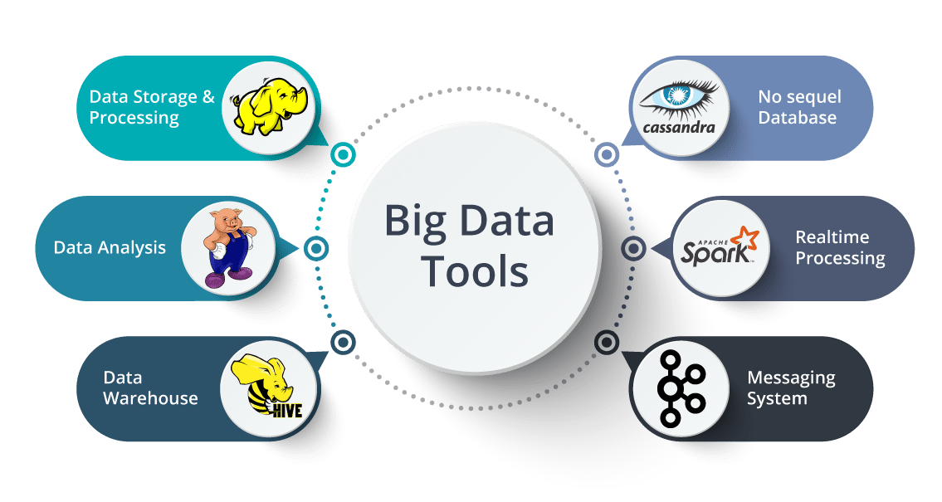

Slide 14
WHY STUDY BIG DATA ?

Slide 15
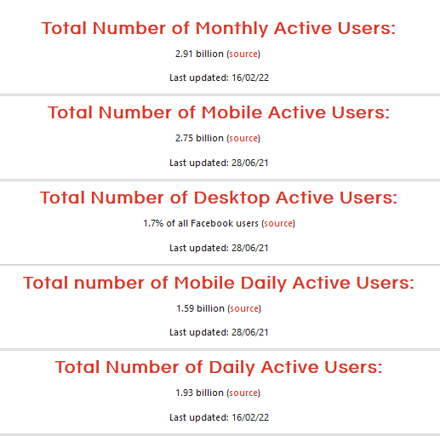
SOME STATISTICS (FACEBOOK)

Slide 16
SOME STATISTICS (WHATSAPP)
1. WhatsApp currently has more than 2 billion active users
Think about that for a second. There are a little over 7.5 billion people on earth, which means more than a quarter of the entire global population uses WhatsApp.
2. Around 100 billion WhatsApp messages are sent each day…
3. And over 100 million voice calls made
That’s around 1,100 calls per second.
4. The average Android WhatsApp user spends around 19 hours on the app per month
5. WhatsApp is the 3rd most used social platform in the world

Slide 17
SOME STATISTICS (INSTAGRAM)
1. The number of global Instagram monthly users is expected to reach the 1.2 billion mark by 2023.
In 2019, Instagram had almost 815 million
2. India was the leading country with over 201 million Instagram users as of October 2021.
3. The most popular Instagram post generated 55.1 million likes as of June 2021.
As of June 2021, the most popular post on Instagram is a photo of an egg posted by the account @world_record_egg

Slide 18
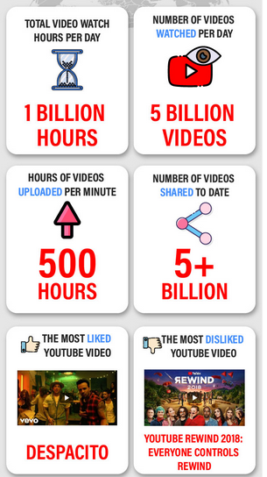
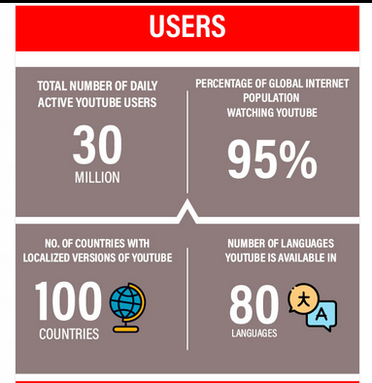
SOME STATISTICS (YOUTUBE)

Slide 19
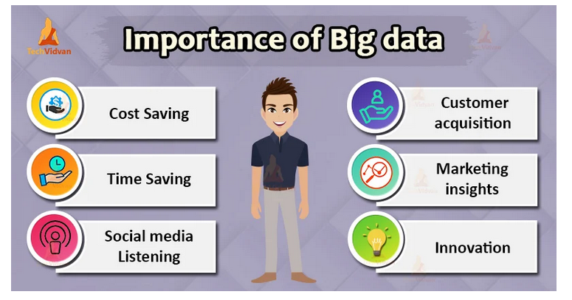
Why Big Data – Benefits and Importance of Big data
In today’s world, social applications are extensively used. It results in rapid data growth.
On social media platforms, billions of users connect daily, users share information, upload images, videos, and many more.
This rising Big Data is not an overhead anymore. Companies are using this it to achieve growth and defeat their competitors.

Slide 20
What is Big Data?
Big Data refers to massive amounts of data produced by different sources like social media platforms, web logs, sensors, IoT devices, and many more.
It can be either structured (like tables in DBMS), semi-structured (like XML files), or unstructured (like audios, videos, images).
Traditional database management systems are not able to handle this vast amount of data.
Big Data helps companies to generate valuable insights.
Companies use Big Data to refine their marketing campaigns and techniques. Companies use it in machine learning projects to train machines, predictive modeling, and other advanced analytics applications.

Slide 21
Why Big Data?
Big Data initiatives were rated as “extremely important” to 93% of companies. Leveraging a Big Data analytics solution helps organizations to unlock the strategic values and take full advantage of their assets.
It helps organizations:
To understand Where, When and Why their customers buy
Protect the company’s client base with improved loyalty programs
Seizing cross-selling and upselling opportunities
Provide targeted promotional information
Optimize Workforce planning and operations
Improve inefficiencies in the company’s supply chain
Predict market trends
Predict future needs
Make companies more innovative and competitive

Slide 22
Why Big Data?
Companies are using Big Data to know what their customers want, who are their best customers, why people choose different products.
The more a company knows about its customers, the more competitive it becomes.
We can use it with Machine Learning for creating market strategies based on predictions about customers. Leveraging big data makes companies customer-centric.
Companies can use Historical and real-time data to assess evolving consumers’ preferences

Slide 23
Importance of Big data
Big Data importance doesn’t revolve around the amount of data a company has. Its importance lies in the fact that how the company utilizes the gathered data.
The companies in the present market need to collect it and analyze it because:
1. Cost Savings
Big Data tools like Apache Hadoop, Spark, etc. bring cost-saving benefits to businesses when they have to store large amounts of data. These tools help organizations in identifying more effective ways of doing business.
2. Time-Saving
Real-time in-memory analytics helps companies to collect data from various sources. Tools like Hadoop help them to analyze data immediately thus helping in making quick decisions based on the learnings.

Slide 24
Importance of Big data
3. Understand the market conditions
Big Data analysis helps businesses to get a better understanding of market situations.
For example, analysis of customer purchasing behavior helps companies to identify the products sold most and thus produces those products accordingly. This helps companies to get ahead of their competitors.
4. Social Media Listening
Companies can perform sentiment analysis using Big Data tools. These enable them to get feedback about their company, that is, who is saying what about the company.
Companies can use Big data tools to improve their online presence.
5. Boost Customer Acquisition and Retention

Slide 25
Real-Time Benefits of Big Data
Big Data analytics has expanded its roots in all the fields. This results in the use of Big Data in a wide range of industries including Finance and Banking, Healthcare, Education, Government, Retail, Manufacturing, and many more.
There are many companies like Amazon, Netflix, Spotify, LinkedIn, Swiggy,etc which use big data analytics. Banking sectors make the maximum use of Big Data Analytics.
Big Data analytics help retailers from traditional to e-commerce to understand customer behaviour and recommend products as per customer interest. This helps them in developing new and improved products which help the firm enormously.

Slide 26
Real-Time Benefits of Big Data
Big data is used by medical professionals to understand patient behavior better and to improve diagnosis.
For example, doctors may be able to track symptoms of a disease in real-time by observing activity on social media and other medical records and determine proper treatments for patients or even predict outbreaks.
Financial organizations use big data to monitor a company’s financial health and make better decisions about its loans.
Big data is used by government agencies such as the Department of Homeland Security to analyze social media comments for potential threats against national security.

Slide 27

Instruction to students
Lab coat and id card is compulsory for the students.
Getting into the lab onetime is strictly followed.
Observation should get sign on the day of completion of the experiments.
Records must be submitted to next lab of completion of the experiments otherwise marks will be reduced.
No makeup exam for assessments and midterm lab examination.
During placement inform your corresponding course instructor and give the name list of students with signature from placement in charge, other wise it is consider as absent.
Once the attendance is marked in ERP it is not changeable

Slide 28


